Slide 1
Lecture Title: Recursion (Cont.)
Recurrences & Master Method
Course Code: CSC 2211
Course Title: Algorithms
Dept. of Computer Science
Faculty of Science and Technology
Lecture No: | 04 | Week No: | 04 | Semester:
Lecturer: | Name & email: Md. Manzurul Hasan, manzurul@aiub.edu

Slide 2
Lecture Outline
Divide and Conquer (Previous Week)
Recurrences in Divide and Conquer and methodologies for recurrence Solutions (Previous Week)
Repeated Backward Substitution Method (Previous Week)
Substitution Method (Previous Week)
Recursion Tree
Master Method

Slide 3
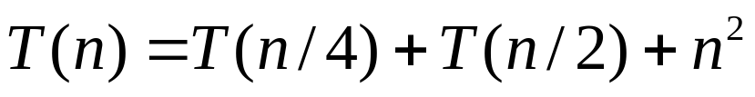
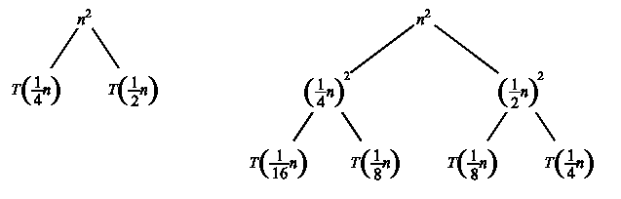
Recursion Tree
A recursion tree is a convenient way to visualize what happens when a recurrence is iterated.
  Good for ”guessing” asymtotic solutions to recurrences

Slide 4
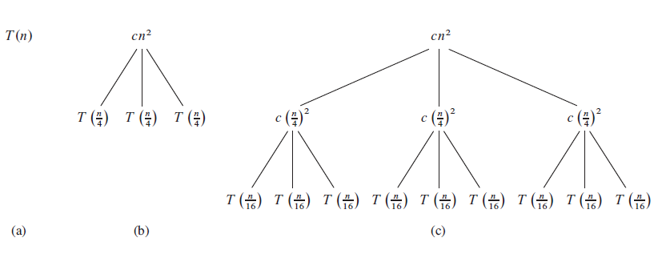

Slide 5
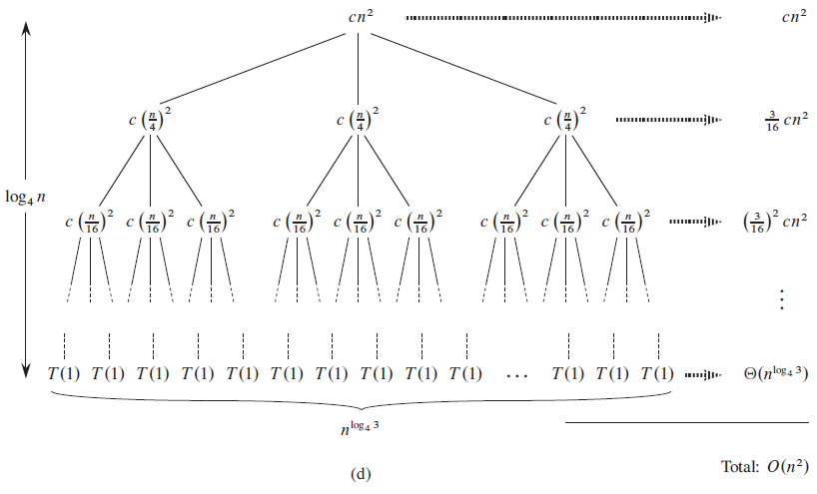

Slide 6
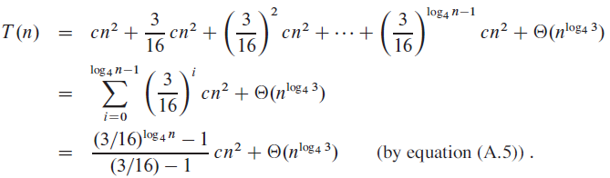
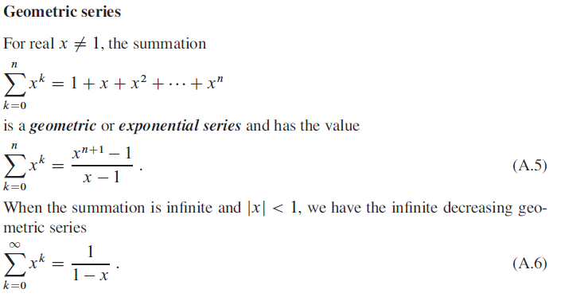

Slide 7
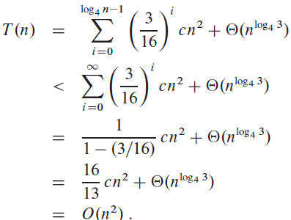

Slide 8
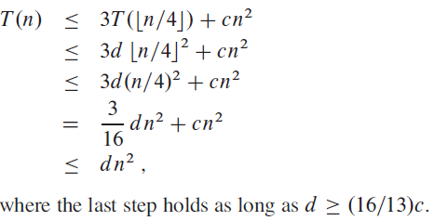
Verify our guess [substitution]

Slide 9

Master Method
The idea is to solve a class of recurrences that have the form
T(n) = aT(n/b) + f(n)
Assumptions: a ≥ 1 and b > 1, and f(n) is asymptotically positive.
Abstractly speaking, T(n) is the runtime for an algorithm, and we know that
  a number of subproblems of size n/b are solved recursively, each in time T(n/b).
  f(n) is the cost of dividing the problem and combining the results. e.g., In merge-sort .

Slide 10
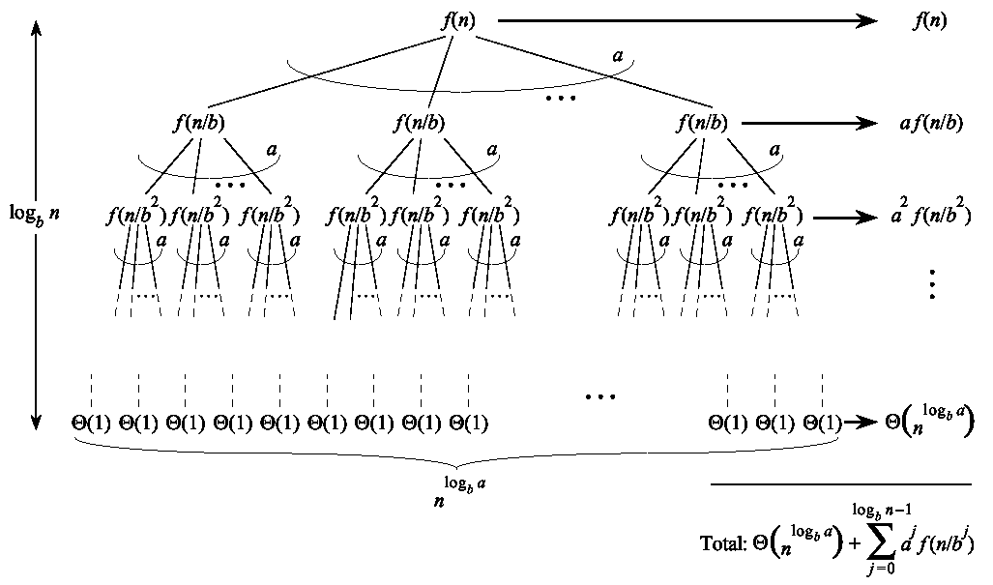


…Master Method
Split problem into a parts. There are
log_{b}n levels. There are leaves.

Slide 11
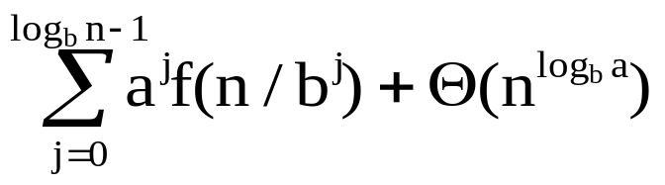
…Master Method
Iterating the recurrence (expanding the tree) yields
T(n) = f(n) + aT(n/b)
= f(n) + af(n/b) + a²T(n/b²)
= f(n) + af(n/b) + a²f(n/b²) + …
a^{log}b^{n-1}f(n/b^{log}b^{n-1}) + a^{log}b^{n}T(1)
T(n) =
The first term is a division/recombination cost (totaled across all levels of the tree).
The second term is the cost of doing all subproblems of size 1 (total of all work pushed to leaves).

Slide 12
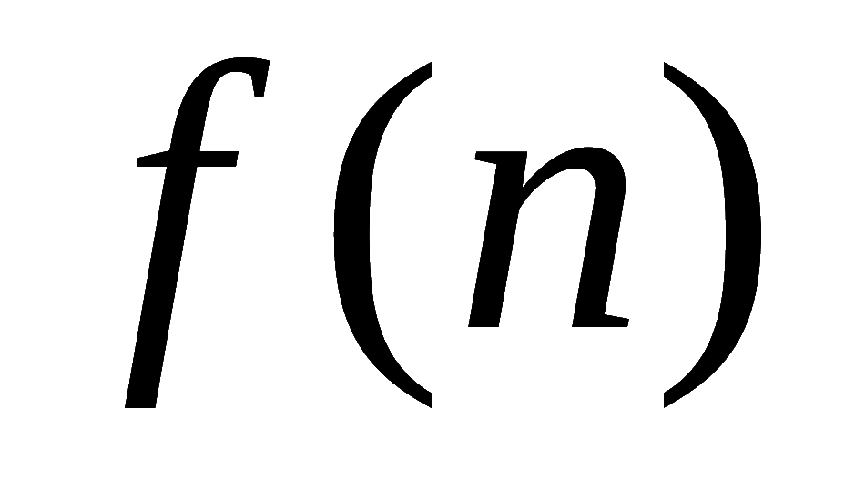
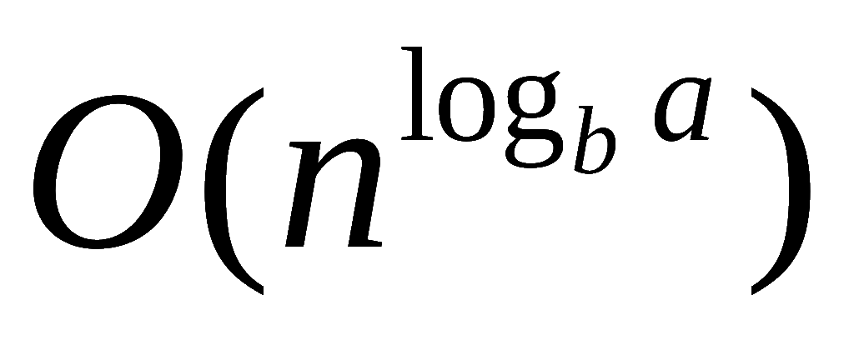
Master Method, Intuition
Three common cases:
  Running time dominated by cost at leaves.
  Running time evenly distributed throughout the tree.
  Running time dominated by cost at the root.
To solve the recurrence, we need to identify the dominant term.
In each case compare with

Slide 13
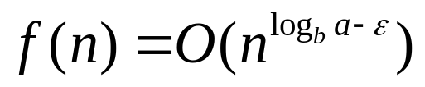

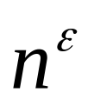
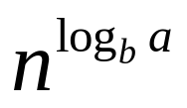
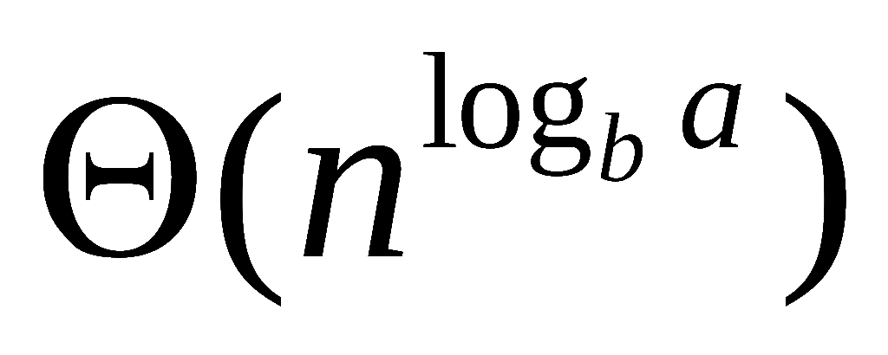
Master Method, Case 1
If for some constant then
  f(n) grows polynomially slower than (by factor ).
The work at the leaf level dominates
  Cost of all the leaves

Slide 14
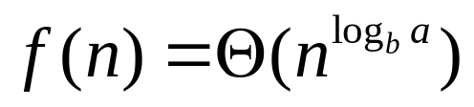
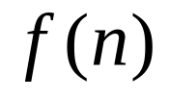
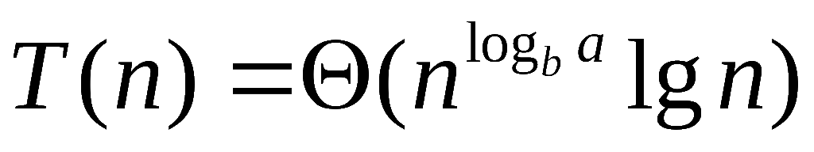
Master Method, Case 2
If then
  and are asymptotically the same
The work is distributed equally throughout the tree
      (level cost)(number of levels)

Slide 15
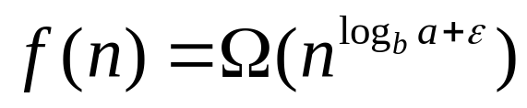
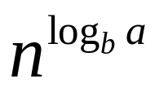
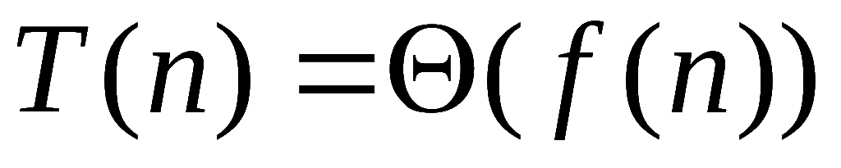
Master Method, Case 3
If for some constant then
  Inverse of Case 1
  f(n) grows polynomially faster than
  Also need a “regularity” condition
The work at the root dominates
  division/recombination cost

Slide 16
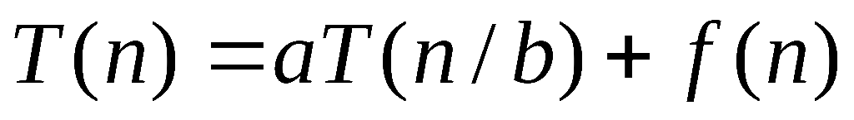
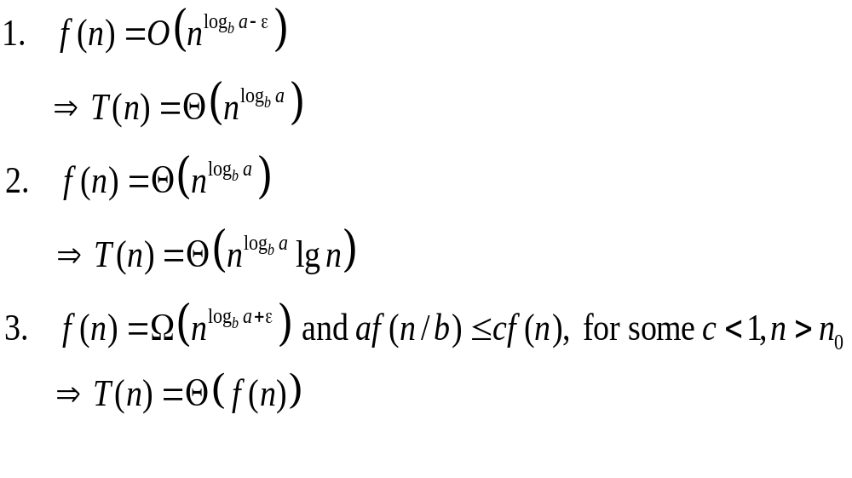
Master Theorem, Summarized
Given: recurrence of the form

Slide 17
Strategy
Extract a, b, and f(n) from a given recurrence
Determine n^{log}b ª
Compare f(n) and n^{log}b ª asymptotically
Determine appropriate MT case and apply it
Merge sort: T(n) = 2T(n/2) + Q(n)
1. a=2, b=2, f(n) = Q(n)
2. n^{log}2² = n
3. Q(n) = Q(n)
➔ Case 2: T(n) = Q(n^{log}bªlog n) = Q(n log n)

Slide 18
Examples of Master Method
BinarySearch(A, l, r, q):
m := (l+r)/2
if A[m]=q then return m
else if A[m]>q then
BinarySearch(A, l, m-1, q)
else BinarySearch(A, m+1, r, q)
T(n) = T(n/2) + 1
1. a=1, b=2, f(n) = 1
2. nlog21 = 1
3. 1 = Q(1)
➔ Case 2: T(n) = Q(log n)

Slide 19
...Examples of Master Method
T(n) = 9T(n/3) + n
1. a=9, b=3, f(n) = n
2. nlog39 = n2
3. n = Q(nlog39 - e) with e = 1
➔ Case 1: T(n) = Q(n2)

Slide 20
...Examples of Master Method
T(n) = 3T(n/4) + n log n
1. a=3, b=4, f(n) = n log n
2. nlog43 = n0.792
3. n log n = W(nlog43 + e) with e = 0.208
➔ Case 3:
regularity condition: af(n/b) <= cf(n)
af(n/b) = 3(n/4)log(n/4) <= (3/4)nlog n = cf(n) ;with c=3/4
T(n) = Q(n log n)

Slide 21
References & Readings
CLRS
  Chapter: 4 (4.1-4.3)
  4.4 for bedtime reading
  Exercises
    4.1, 4.2, 4.3
  Problems
    4-1, 4-4
HSR
  Chapter: 3 (3.1-3.6)
  Examples: 3.1-3.5
  Exercises: 3.1 (1, 2), 3.2 (1, 3-6),

